Slide 1
CSE115
Programming Language I
Md Mohaiminul Islam
Lecturer, Dept. of ECE
Lecture 04
Version 1: Last updated 29 Sept ‘26

Slide 2
Recap
We had learnt what other number systems there are, how to convert decimal numbers to them and vice versa.
The core philosophy is to represent your number as powers of the base that you want to convert to.
We also saw 2¹⁰ = 1024 ~= 1000 = 10³, which leads to interesting terminologies and approximations

Slide 3
Adding 2 Numbers
How do we add 2 numbers in decimal?
We simply start from the "right", add the digits, write down the summation's right digit in this place, and carry a +1 to the left if needed, and repeat.
That's literally the same step for any number system. The only thing that changes is the definition of '10'.
In binary, 1+1 makes 10. In Octal, 8 is 10 which can be 7+1, or 5+3 or anything else.
And we already knew this from the number conversion logic, so nothing new.

Slide 4
Let's add
Decimal | Binary | Octal | Hexadecimal
23 | 10110 | 720 | 3B35
+ 491 | + 1101 | + 531 | + A67C

Slide 5
Let's add
Decimal | Binary | Octal | Hexadecimal
23 | 10110 | 720 | 3B35
+ 491 | + 1101 | + 531 | + A67C
4(11)4 | 11(10)11 | 1451 | D(11)A(11)
514 | 100011 |  | E1B1

Slide 6
Let’s add
When adding 5 to C in hexadecimal, you can
  Convert C to decimal 12, add 5 and get 17 result in decimal, convert it back to hexadecimal which is 11
  Directly add 5 with C in hexadecimal. It’s not too difficult actually, count in your fingers. For adding 5, start with 1 which you call D (which comes right after C) and go upto 5. Your counts should be like:
    D, E, F, 10, 11, 12…
    Stop yourself at the 5th number since that’s exactly how many you needed to add.
    See, the result is indeed 11 in hexadecimal.
    The key thing is to notice when you need to reset and loop around to 10.

Slide 7
Bits and Bytes
In binary, every 'digit's are actially called bits.
Think of bits = binary digits
8 bits together are called a 'byte’
In computer science, you’ll often see that many things are actually computed as a whole byte, not as 8 separate bits.

Slide 8
Data types
Data type | Represents | Example | Space | Value range | Format Specifier
int | integer, whole number | 37, 910, 7871023, -55, 0, -989824 | 4 bytes = 32 bits | [–2³¹, 2³¹ – 1] | %d
char | character, letter | 'A' to 'Z', 'a' to 'z', punctuation marks, '0' to '9' | 1 byte = 8 bits | [0, 2⁸ – 1] | %c
double | fractional number | 2.31, 9832.03, -3.0, -0.001 | 8 bytes = 64 bits | ±1.7 × 10³⁰⁸ | %lf
float | same | same | 4 bytes | ±3.4 × 10³⁸ | %f

Slide 9
Arithmetic Operators
Operator | Operation | Example | Results
+ | Add | 3 + 5 22 + 3.1 'e' + 2 | 8 25.1 'g'
- | Subtract | 3 – 5 2 - 1.5 'e' - 2 'e' - 'a' | -2 0.5 'c' 4
* | Multiplication | 3 * 5 2.1 * 2.0 | 15 4.2

Slide 10
Arithmetic Operators (2)
Operator | Operation | Example | Results
/ | Division | 6 / 3 11 / 3 11 / 3.0 | 2 3 3.66666...
% | Remainder / Modulus | 6 % 3 11 % 3 -1 % 3 | 0 2 -1

Slide 11
Arithmetic Operation (Detail)
There are some weird operations we can observe
Division between 2 integers omits the fractional part (if any). It has a special name and is called integer division
% is a remainder operation, simply returns the remainder via dividing first/left operand by second/right operand
It feels a bit weird for negative numbers. The logic is that it simply takes the remainder of the positive part and puts a – sign before it
The real weird operation takes place when adding/subtracting characters

Slide 12
Arithmetic Operation on chars
It seems we can add some numbers to a letter and get future letters
'e' + 3 = 'h' (...d, e, f, g, h, i...)
And similar logic also allows us to get 'e' - 3 = 'b'
Aaaand... if we really stretch this definition, we can even get 'e' - 'b' = 3
Why does this work? Only because characters are, under the hood, simply numbers between 0 to 255

Slide 13
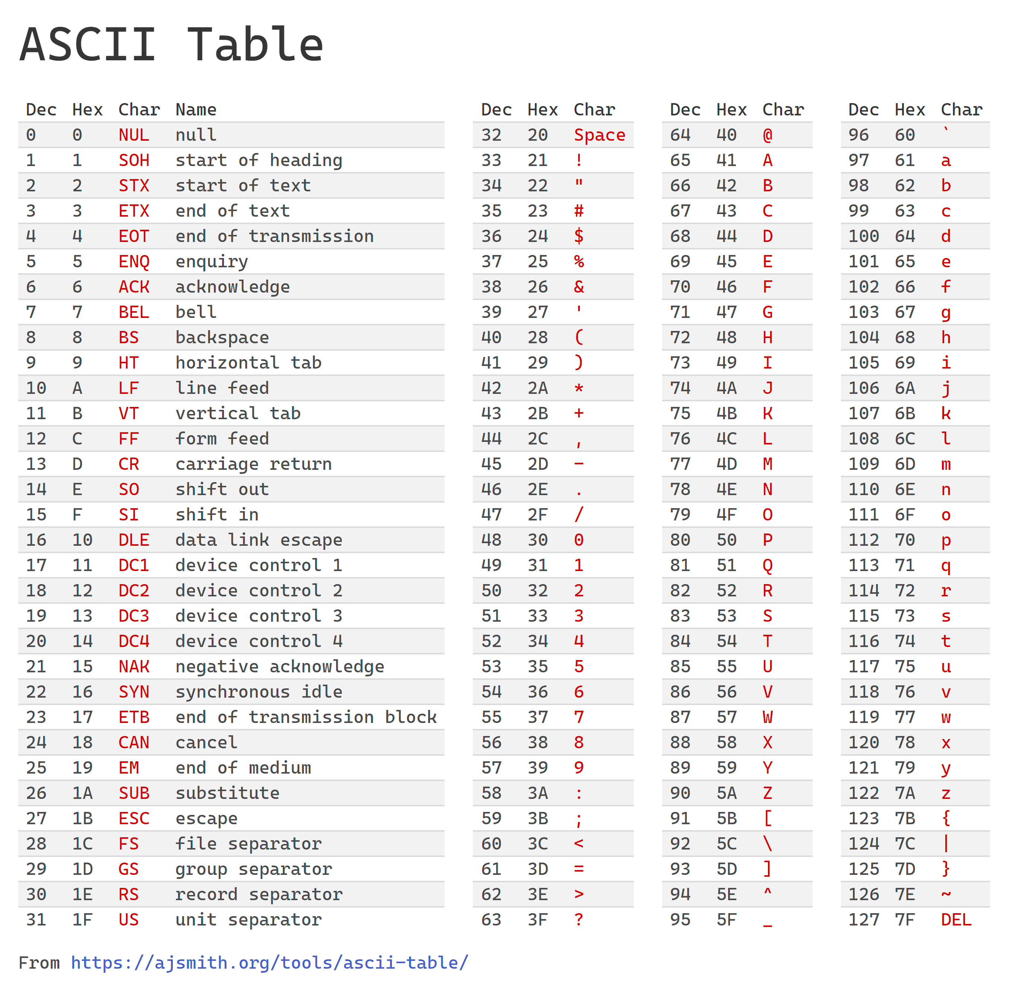
Characters, characters...

Slide 14
Important characters...

Slide 15
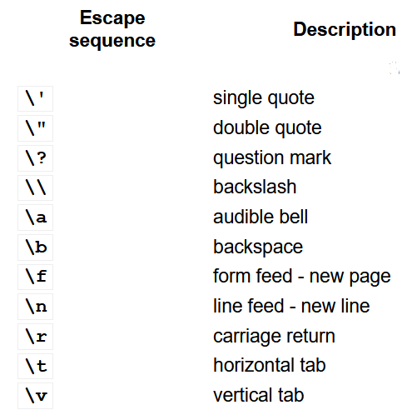
Escape
Sequences
Image from: https://en.cppreference.com/cpp/language/escape

Slide 16
Arithmetic Operation on doubles
We can also see that fractional numbers are "dominating" i.e. any operation between an int and a double always results in double
It is expected since the fractions form a larger class of numbers than whole numbers
int p = 4.6; // p stores 4
double q = 4; // q stores 4.0
double x = 2 * 3; // x becomes 6.0
int y = 2.5 * 4.1; // y stores 10
double z = 6 / 4; // what will z store? 1.5?

Slide 17
Arithmetic Operation on doubles
double z = 6 / 4; // what will z store? 1.5?
No. The result of 6/4 (on the right-hand side of assignment operator =) is already 1, due to integer division. Storing it in a double-type variable won't magically bring back the missing 0.5
What you want is the exact act of division to happen on directly on double to avoid integer division
You can achieve that via
  type casting: (double) 6 / 4
  implicit type conversion: 6.0 / 4

